Slide 1
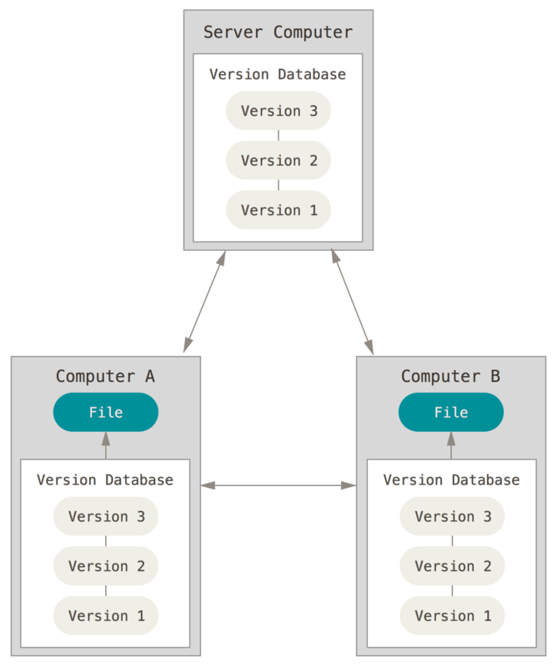
Version control - git
What is a version control system?
Why we need it?
Let’s understand what problem it solves.
How version control solves problem

Slide 2
Version Control…..
Keeps record of the code changes
Allows collaborative development
Records who made what changes and when
Allows to revert any changes

Slide 3
Types of Version control Systems Available
Local Version Control System A local version control system is a local database located on your local computer, in which every file change is stored as a patch.
Centralized Version Control System A centralized version control system has a single server that contains all the file versions. Multiple clients to simultaneously access files on the server.
Distributed Version Control System Clients can fully mirror the repository, including its full history. Thus, everyone collaborating on a project owns a local copy of the whole project.

Slide 4
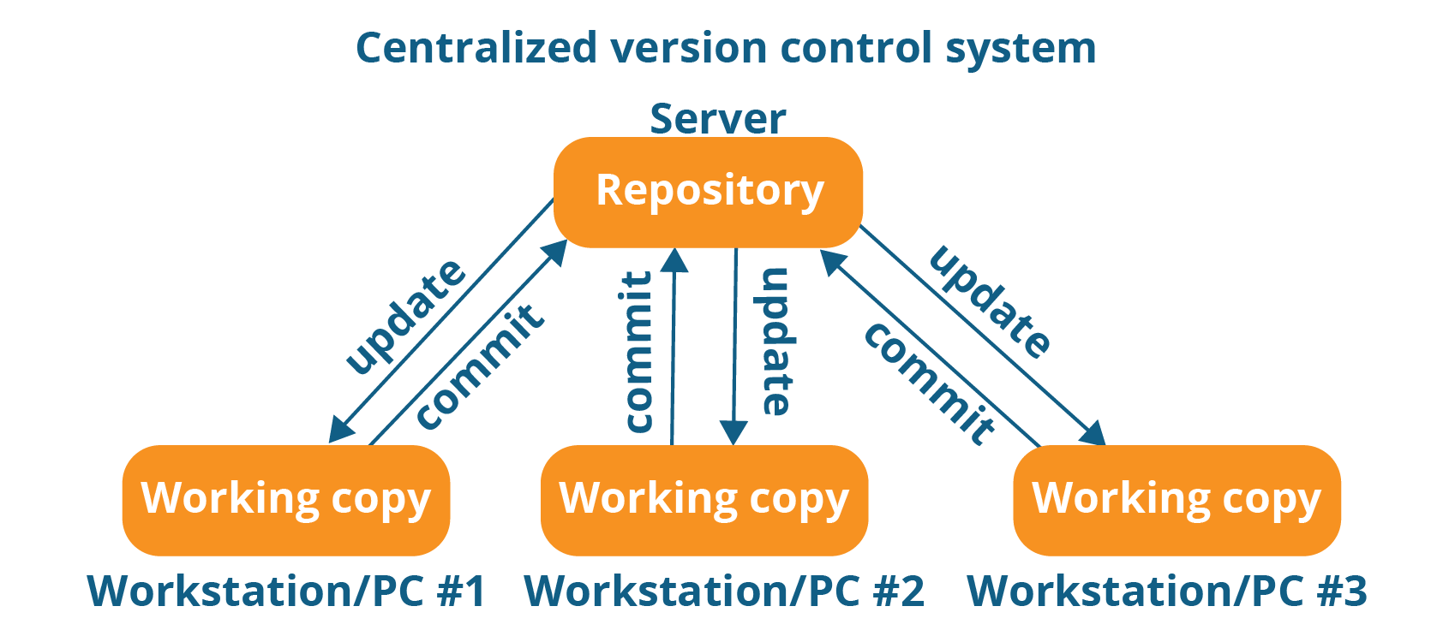
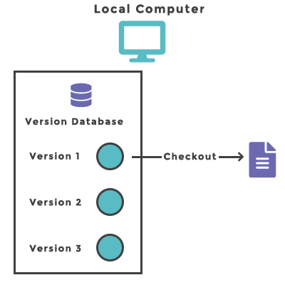
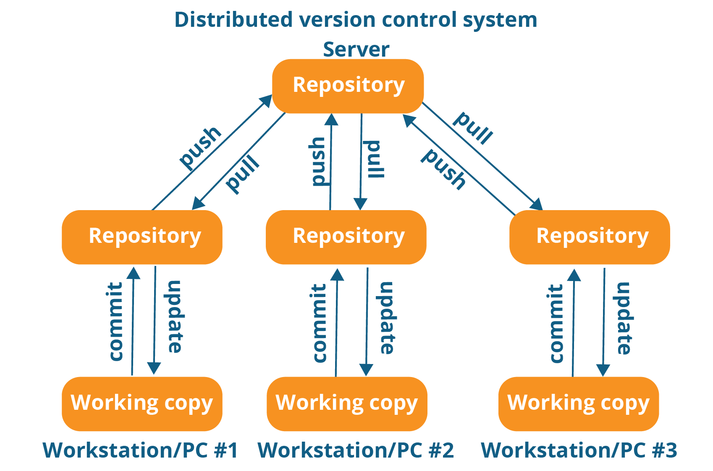

Slide 5





Version Control System Softwares

Slide 6
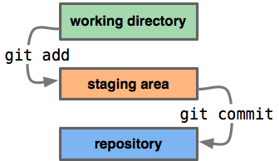
Working with Git
Git works with Repositories.
Repository
A repository contains all of your project's files and each file's revision history. All the project work runs with in the Repo.
All commands start with git
Most of the commands should run inside Git Repos.

Slide 7
Install Git on Windows
Install Git on Linux
Starting to use Git Bash
Register User with Git system - git config commands

Slide 8
Git WorkFlow - LabDemo
Create a Repository in Git – git init .
Find the status of the git repo – git status
Adding files to git repository working directory – Create files from Windows and from Git bash.
Adding files to Staging area – git add file1 file2 (or) git add . (or) git add --all
Commit staged files to local VCS – git commit -m “comment”
Git commit logs done by a user – git log

Slide 9
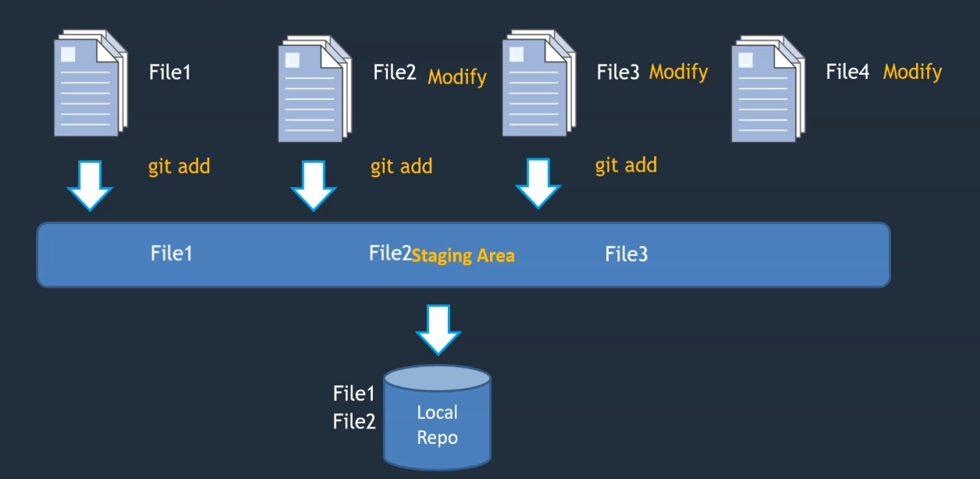
Understanding Git Staging

Slide 10
Git Diff Commands to understand the deference between files.
git diff – compare changes of working directory with staging area
git diff --staged – compare changes of staging area with local repository
git diff HEAD – compare changes of working directory with local repository

Slide 11
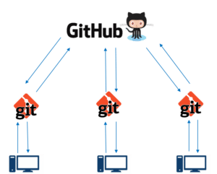
GitHub
GitHub is a code hosting platform for version control and collaboration. It lets the people to work together on projects from anywhere.

Slide 12
Working with GitHub
Creating a GitHub Account
Creating a Repository on GitHub – git init .
Cloning a Repository from GitHub – git clone
Push code on to remote repository GitHub – git add & commit
Working with Repository – git status, log & diff
Collaborating with Other Developer
Clone the Repository from another Developer System
Committing changes from different Developers
Git Clone vs Git Pull
Push conflicts between Developers – git pull

Slide 13
Secure Connecting with GitHub
Git Credentials
What is SSH Connection
Advantages of ssh Connection
Generating ssh keys on Linux and Windows
Establishing a secure connection from local system to GitHub using ssh
Mapping the local Repository to GitHub
Modifying .git configuration file

Slide 14
HEAD -> HEAD is the reference to the most recent commit in the current branch.
master -> Master is the name of a default branch in git terminology. Whenever a new repository is created in git, git gives the default name to a branch master or main.
origin -> "origin" is a shorthand name for the remote repository that a project was originally cloned from. More precisely, it is used instead of that original repository's URL.
Git Diff command: The git diff command helps you see, compare, and understand changes/commits in your project.
All the red color data means, it is changes from previous commit to current commit
All the green color date means, it is deleted from previous commit to present commit.
All the white color data means, it is not changed from previous commit to present commit.
Comparing commit changes with HEAD
git diff HEAD HEAD~1

Slide 15
Checking the changes done by a particular commit.
git show <commit id> or HEAD
Checking a particular file for changes.
git annotate <filename>
Pointing the previous version of Code
git checkout <commit id>
git switch –
Identifying the commit changes in GitHub – git log, show, annotate and checkout
Commit changes directly on GitHub – add file, edit file and upload a file.

Slide 16
Git Branches
What is Git Branches and why do we need it?
Branching Strategy
Working with Branches – Git ang GitHub
Committing and Merging Changes in Branches
Resolving Merge Conflicts in Branches

Slide 17
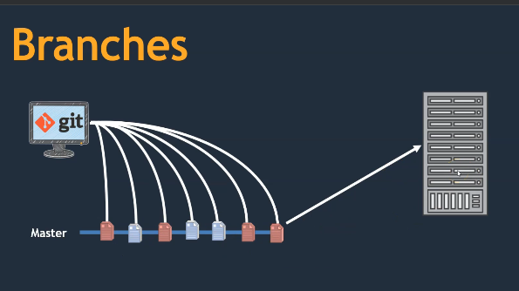
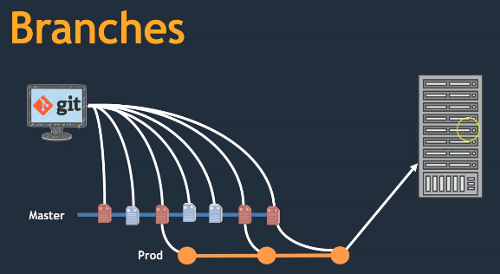
Git Branches – what problem it solves?

Slide 18
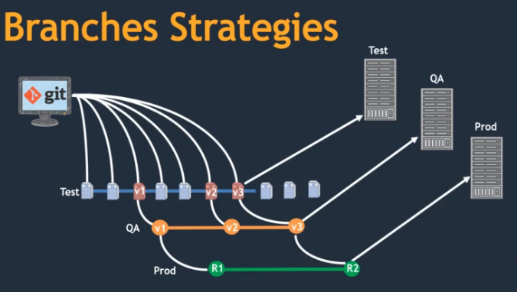
Branching Strategies – Dev, Stg and Prod
Creating a Branch in GitHub
Working with Branches in Git

Slide 19
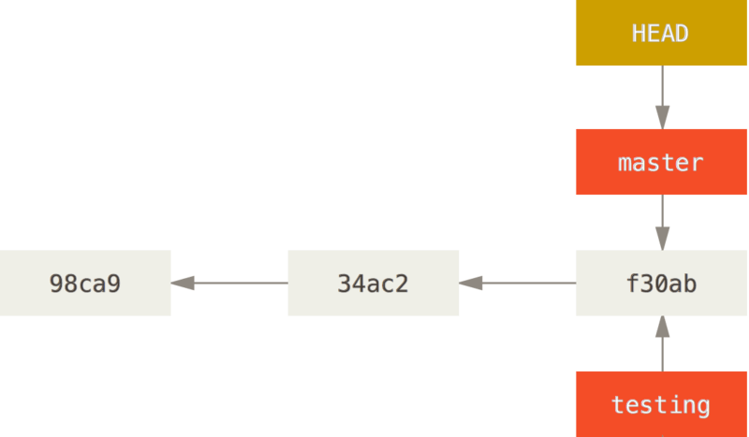
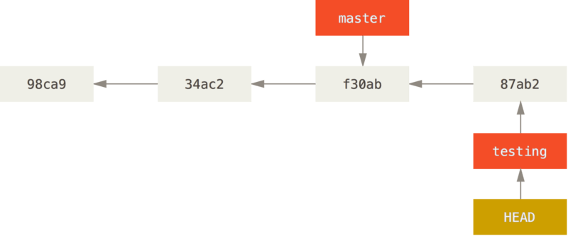
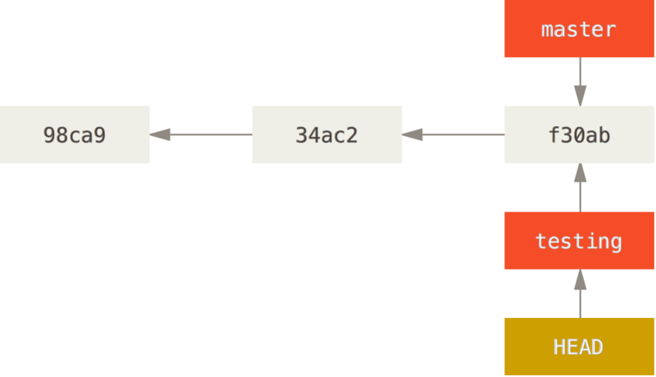
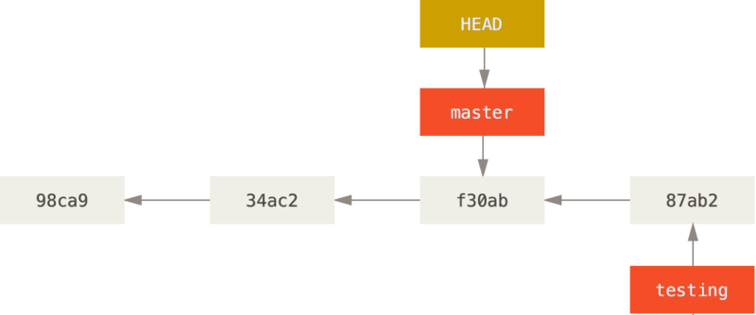
HEAD pointing to master
New commit on testing
HEAD pointing to testing
New commit on master

Slide 20
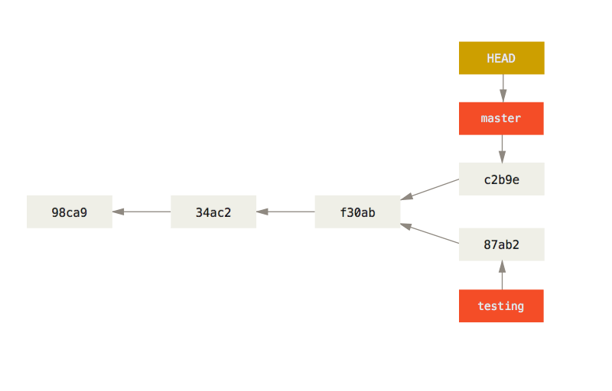
Both master and testing have two deferent commits.

Slide 21
Working with Merge Conflict between Branches
Forking a Repository
Updating files in directories and subdirectories and check with git log
Creating Pull Request
Deference between Clone, Merge and Pull
Working with Private Repositories.
Adding Collaborator to a GitHub Repository
Working with Protected Branches

Slide 22
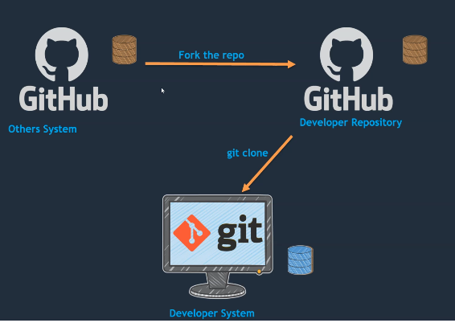
Pull Request

Slide 23
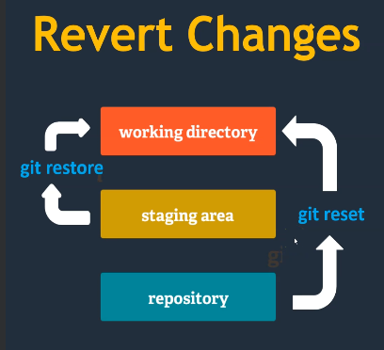
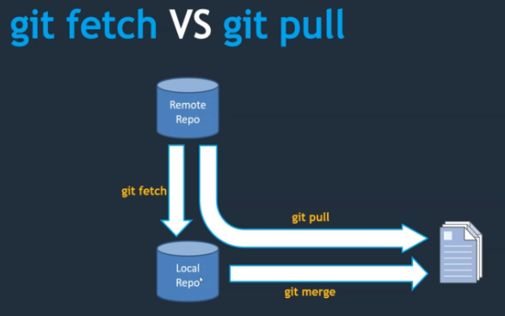
Advanced Concepts
- Reversing changes from Working Directory -> git restore (or) git checkout --
- Reversing changes from Staging area to Working Directory-> git restore – staged
- Reverting changed from Local repo to working directory -> git reset HEAD~
- Using .gitignore
- Git rebase -> git rebase -i HEAD~<number>
- Git fetch vs Git pull

